Slide 1
The SK-Learn Files
Sniffing Crime with Data Science

Slide 2
Project Scope
Goals:
Predict Serious Crimes
Resource Management
Audience:
SFPD
Emergency Response Services
Government
Notes:
Serious Crimes – Requires Mobilization of Multiple Units
Help better prioritize the deployment of resources
Budgeting, Hiring

Slide 3
Crime Data at a glance
SF Crime Data - Kaggle
2.215 Million Cases since 2003
~150K per year
~411 cases per day

Slide 4
Target & Features
Crime Classes: Level 1 - Serious, Violent, High Priority Level 2 - Potential to Escalate Level 3 - Non-Violent, Low Priority
Time of Day: Morning - 6am to 12pm Afternoon - 12pm to 6pm Night - 6pm to 12am Late Night - 12 am to 6am
Day of Week: SMTWTFS
Police Districts: 10
Notes:
All Categorical Features
Level 1 – Serious & Violent, High Priority Level 2 – Potential to Escalate Level 3 - Non-Violent, Low Priority

Slide 5
Crime Classes
Description | Counts | Class
WARRANT ARREST | 56230 | 1
ROBBERY ON THE STREET, STRONGARM | 15063 | 1
FORCIBLE RAPE, BODILY FORCE | 2003 | 1
DOMESTIC VIOLENCE | 18488 | 2
PAROLE VIOLATION | 10560 | 2
SUSPICIOUS ACT TOWARDS FEMALE | 2000 | 2
TRAFFIC VIOLATION | 38105 | 3
BURGLARY OF APARTMENT HOUSE, UNLAWFUL ENTRY | 11828 | 3
STOLEN AUTOMOBILE | 64763 | 3
Notes:
40 Category Features
950 Descriptions
Level 1 – Serious & Violent, High Priority Level 2 – Potential to Escalate Level 3 - Non-Violent, Low Priority

Slide 6
Classifiers
Logistic Regression
Naïve Bayes
Gaussian
Bernoulli
Multinomial
Decision Tree
Random Forest
Adaboost
Notes:
Balanced weight vs. Arbitrary

Slide 7
Class Imbalance
Class 1: 15%
Class 2: 10%
Class 3: 75%
SMOTE, ADASYN
Notes:
This makes sense, because most of the time, there is not going to be a shootout or bank robbery.
Most 9-11 (non-medical) calls are going to be after the fact, or just require a police report rather than police officers being there.

Slide 8
3 Classes
Crime Class | Precision | Recall | F-1 Score
1 | .15 | .64-.74 | .24-.25
2 | .12 | .11 | .12
3 | .76 | .20 - .29 | .31 - .42
Model Accuracy - .265-.322
Notes:
Even After Resampling with SMOTE and ADASYN > better fitted model
(Adasyn didn’t make a whole lot of difference)

Slide 9
Reframing The problem
2 Classes vs. 3 Classes
1 + 2 vs. 3
New Class 1 = Class 1 + Class2
Notes:
Human Trafficking was defined as Class 2
After running all the models with 3 classes
Resampling vs No-Resampling vs Arbitrary Weighting

Slide 10
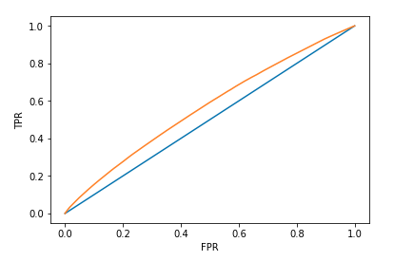
Random Forest – 2 classes
Crime Class | Precision | Recall | F1-Score
1 | .29 | .53 | .38
3 | .78 | .56 | .65
Accuracy = .552
AUC = .57

Slide 11
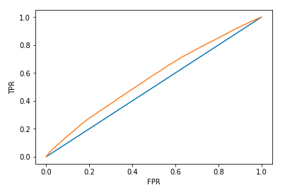
Adaboost – 2 classes
Crime Class | Precision | Recall | F1-Score
1 | .29 | .52 | .37
3 | .77 | .56 | .65
Accuracy = .552
AUC = .56

Slide 12
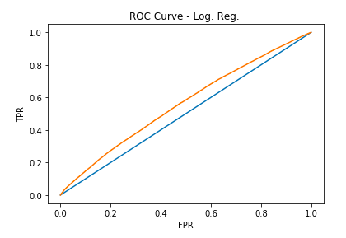
Logistic Regression – 2 classes
Crime Class | Precision | Recall | F1-Score
1 | .29 | .55 | .38
3 | .78 | .53 | .63
Accuracy = .539
AUC = .56

Slide 13
Conclusion
Defining Crime Classes
Redrawing Boundaries
Notes:
Based on the 2-class models, it performs consistently better than randomly guessing
HOWEVER, given the limited information from this data, the fact that this model was able to predict class 1 crimes with > 50% recall, accuracy… is not bad
With better information from SFPD, we can definitely create a better model
EX. Stolen Auto Mobile by district and time
Tier Classes

Slide 14
Future Work
District x Time Series Analysis
Input from SFPD
Geo Location to identify Clusters
Notes:
Future Work:
District-Based Analysis – see which district the model works especially well for
Time series analysis to predict trend in crime activity by district
With better information from SFPD, we can definitely create a model that performs better than randomly guessing (50%)
Clarification on Description would be very helpful > better classification of the crimes, and perhaps have more than 3 classes.
Domain Knowledge / Recent Trends

Slide 15
Questions?
THANK YOU!

Slide 16
Appendix
Sources:
Kaggle
https://www.sfchronicle.com/bayarea/article/SF-mayor-proposes-hiring-hundreds-of-new-police-12914231.php

Slide 17
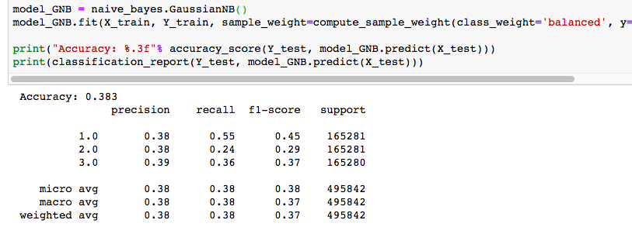
Naïve Bayes

Slide 18
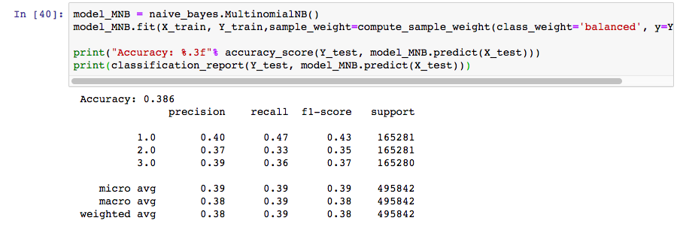
Naïve Bayes

Slide 19
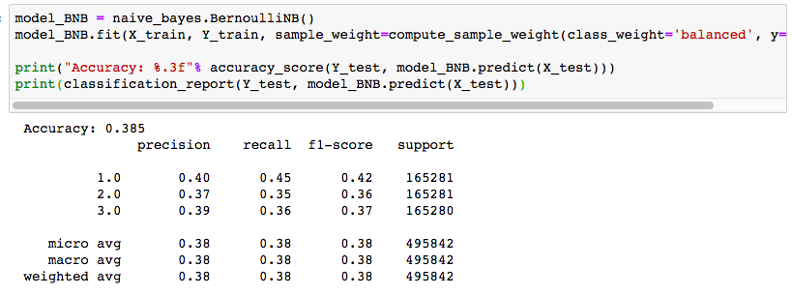
Naïve Bayes

Slide 20
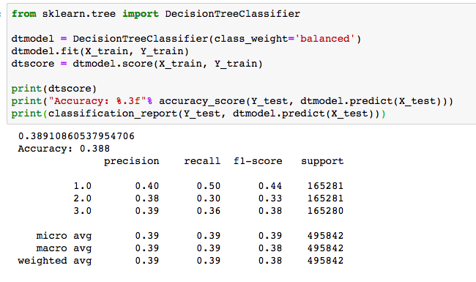
Decision Tree Classifier

Slide 21
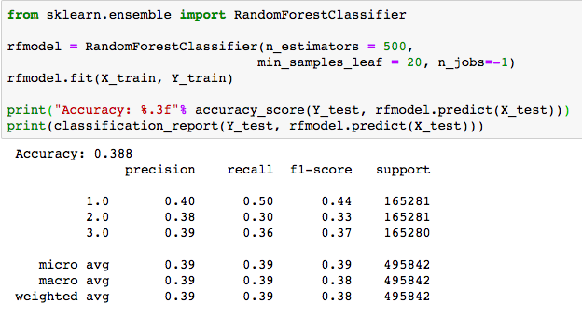
Random Forest

